Slide 1
ESA ID: TIAA ALEXA Digital Assistant
PM ID and Name: (611198) Pushparaj R
Review Date: 26/07/2019

Slide 2
Agenda
TIAA Alexa Skill – User Experience
What we did in 2019
Execution Model
Delivery Metrics
SPD / Devops
Best Practices, Business Ideas & Value-adds
Challenges
2019 Roadmap
Appendix

Slide 3
TIAA Alexa Skill – User Experience
#3

Slide 4
TIAA Alexa Skill – End User / Participant in Digital Assistant Journey
Echo Devices
User acquires Alexa enabled devices such as Echo Dot, Echo show/spot
Download
Echo app
User plugs the Echo device and download the companion app to their phone or tablet
Device
Set Up
User starts the setup process by opening the companion app and connect the Echo device to the internet
Enable TIAA Alexa Skill
User enables the TIAA Alexa skill from the companion app
Voice Interaction
User interacts with Alexa through voice and ask TIAA related queries

Slide 5
TIAA Alexa Skill – End User / Participant in Digital Assistant Journey
Ask TIAA for nearest advisor/office
User gets the location information either from IOT or YEXT services
Ask TIAA for market quote/symbol
User receives the up-to-date stock quote or symbol for the inquired company name
Ask TIAA to play Trivia game
User plays the quiz about TIAA and TIAA related functions
Ask TIAA to get the availability of tax forms
User gets the availability of the following tax form
5498
1099 B, R, Q, INT, DIV and LTC
Ask TIAA for market performance
User receives the up-to-date performance for the inquired market name. i.e. Dow Jones, S&P, NASDAQ

Slide 6
TIAA Alexa Skill
What we did in 2019

Slide 7
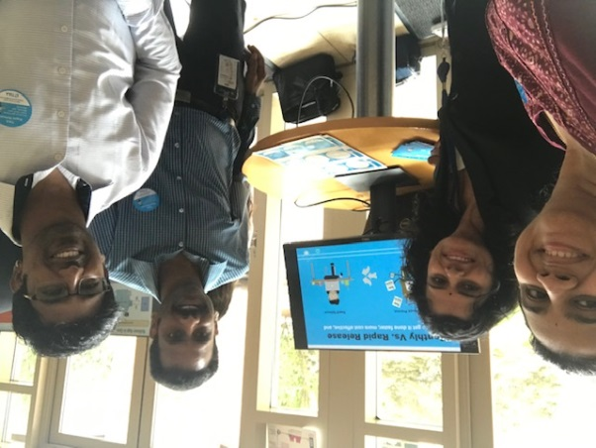
TIAA Alexa Skill – 2019 Delivery Highlights
Alexa – First Voice Assistant
Alexa is the first Voice Assistant, where RoboAdvisor is the first client-facing web application to migrate to OpenShift platform and perform rapid release using Blue-Green deployment style - powered by Gitlab CI, ElectricFlow CD and OpenShift. Move to OpenShift also provides on-demand scaling, operational efficiency and continuous delivery capabilities.
Why:
Short duration: substantially reduce the release window duration from days to minutes.
Lower risk: make software deployments low-risk events by applying patterns like blue-green deployment to achieve zero-downtime deployments.
Lower costs: reduce the cost of making changes to production.
Happier teams: make releases less painful and reduce team burnout
Faster time to market: Reduce lead time to deliver value to customers.
Expo table/booth to talk about Rapid Release outside the venue of Scott’s Townhall.
Impact/Result:
Reduce release duration from 3 days to <1 hour.
Simplified release process demands fewer artifacts and approvals.
Deployment and checkout happens during week days.
What Cognizant did:
Cognizant was pivotal in the first Rapid release of RoboAdvisor.
Analysis and categorization of the configuration files to ensure that the application is ready for OpenShift migration.
Building a CI/CD pipeline with GIT Continuous Integration, ElectricFlow, OpenShift, Docker and AWS technologies.
Integrated SeaLights in CI/CD process to identify and improve the test effectiveness.
Optimized the build process by rewriting the gitlab-ci.yml which helped to reduce the overall build time.
In order to create better visibility on server side issues, team enhanced the Splunk dashboard to use OpenShift logs.

Slide 8
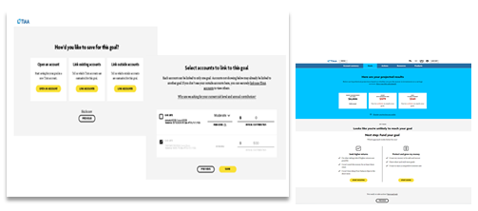
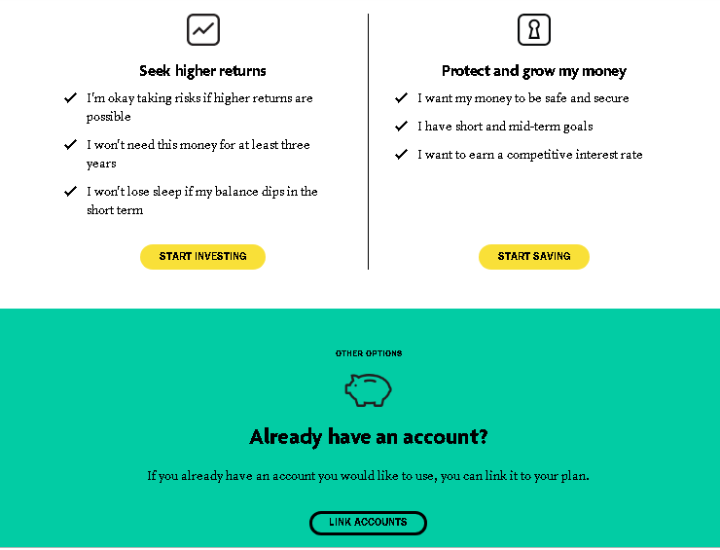
TIAA Alexa Skill – 2019 Delivery Highlights
Integrated YEXT Location Service
February 2019
Additional location services on top of IOT for the nearest advisor
Fetching the advisor/office location from YEXT
Finding nearest advisor/office from YEXT within 20/500 miles radius
Analytics
March 2019
Tagging the user intents and slots via BOOMR analytics
Finding the service call time taken
Passing the session and user details

Slide 9
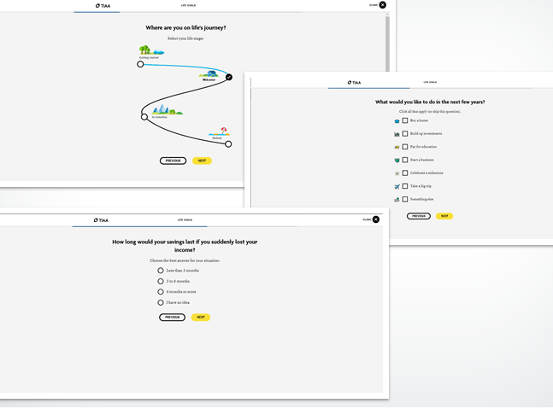
RoboAdvisor – 2019 Delivery Highlights
Responses based on Device TimeZone
April 2019
Introduction of goal profiling in Goal summary view
Life stage selection with Q&A regrading user’s savings & future plans
Recommended goals view on completion of Q&A
Set Goal from recommended goals view
Pick from list feature which navigates to redesigned select goal page
Optional Account Linking
May 2019
Savings & Investing – Enable Projection chart
Savings & Investing – Enable Projection – Bubble view
Redirection to GS flow for IAS(Individual Advisory services) Engaged users
Unit Testing migration to spock framework

Slide 10
RoboAdvisor – 2019 Delivery Highlights
Designed Alexa skill with Visual Experience
June 2019
Introduction of goal profiling in Goal summary view
Life stage selection with Q&A regrading user’s savings & future plans
Recommended goals view on completion of Q&A
Set Goal from recommended goals view
Pick from list feature which navigates to redesigned select goal page
Account Balance Inquiry
July 2019
Savings & Investing – Enable Projection chart
Savings & Investing – Enable Projection – Bubble view
Redirection to GS flow for IAS(Individual Advisory services) Engaged users
Unit Testing migration to spock framework

Slide 11
Execution Model

Slide 12
RoboAdvisor Platform - Future Release
Release Name | Onsite | Offshore | Nearshore | Current Status | Release changes
Sept | 3 | 4 | 0 | CUT | Debt Tool Integration . RIR reports for WM engaged users
Digital Advice Zone
Platform Nature
Business, PM (TIAA)
Followed agile methodologies across the releases
GBS QA will be involved for Sept release
Team Alpha
Team Beta
Scrum Team
Scrum Master (CTS)
Scrum Team
Scrum master (CTS)
Development Team Distribution - 7
Dev (CTS)
Dev(CTS)
Onsite
Coimbatore : 1
Kochi : 3
Dev(GBS)
Dev(GBS))
QA(GBS)
QA(GBS)
Offshore
UX, Prototype (TIAA)
UX, Prototype(TIAA)

Slide 13
Project Gantt Chart and Current State
Sep Release Plan
Phases | 15-Jun | 30-Jun | 17-Jul | 30-Jul | 15-Aug | 23-Aug | 5-Sep | 15-Sep | 30-Sep
CUT
QA
UAT
Regression
Deployment
W. Support

Slide 14
Best Practices, Business Ideas and Value-Adds.

Slide 15
Best Practices
Trunk Based development
All developers commit to one shared branch under source-control. Implemented for Sep release.
GIT Fork
Forking a repository allows you to freely experiment with changes without affecting the original project. Implemented from March release
Quality
Pre-merge quality check
Pre-merge quality check helps in avoiding
sonar violation getting merged into release branch. Implemented from May release.
In TIAA, RoboAdvisor is the first project to implemented these best practices. Many other project teams reach out to TIAA managers who lead RoboAdvisor, to get help in implementing these best practices in their projects.

Slide 16
Business Ideas & Value Adds
AI based Risk Tolerance Calculator
In the existing risk selection process in RoboAdvisor, the user can either select a risk on his own or he could use the Risk questionnaire(RTQ) feature to get a suggested risk. The purpose of the RTQ is to create an accurate risk profile of the client, which becomes the primary factor in selecting their investments. Yet, it still forces clients to take what amounts to a multiple-choice pop quiz, one for which they have not studied, and relies on their answers to build a portfolio that they may be invested in for decades.
Companies like Yodlee could provide access to an enormous quantity of very useful information about a prospective client. It could include the client’s entire investing history plus their personal finance history, including every transaction they ever made, and throw in social media, too. An algorithm could be written to develop a personality profile for the client that would be a better representation of how they would deal with different market scenarios and provide a better understanding of an investor’s risk profile than a questionnaire.
Business Ideas
Enabled the Web unit tests coverage for Typescript files in Sonar Dashboard to show both Java and Typescript coverage percentage.
Integration test suite optimized and the execution time reduced to 2 Minute 50 seconds from 11 Minute 30 seconds.
As part of streamlining the scrum process and tools for Digital Advisor, we created new dashboards in Jira which would help to track the stories and defects effectively based on release and resource effectively.
Value Adds

Slide 17






RoboAdvisor Team – Other Metrics
Highlights
Team is continuously doing research on latest trend in RoboAdvisor and shares comparative study in TIAA perspective.
Research & Development
CCA Status
CCA Status – RoboAdvisor : On Track for CCA target.
GBS Knowledge Sharing
CII contribution
Release Support
Continue to support and provide KT sessions ( Business & Application Knowledge) to the GBS resources
Soft Dollar Savings : 3 Value-Adds, $35K
Offshore team continued to provide support for production releases

Slide 18
Challenges

Slide 19
Challenges
GBS owns the QA execution and Cognizant don’t have any involvement. Since GBS QA’s business knowledge is limited, dev team actively support QA.
Cognizant onsite performs the dual role of Scrum master and Technical lead. There were challenges initially in assigning the work to GBS. But Onsite worked with TIAA managers to sort out the issues.
GBS
Collaboration

Slide 20
2019 Roadmap

Slide 21
Digital Advisor Road Map 2019
July 2019
Sep 2019
Nov 2019
Expand Goal Recommendations Experience
Build the debt management goal experience.
Analytics updates.
Minor UI enhancements.
Retirement Checkup to include Advice, Planning with spouse
Tech Pipeline for 2019
Angular 6 upgrade
Sealights for better quality management
AWS migration.
Spock to be used for unit testing Java code.
Integration of feature experimentation platform spilt.io

Slide 22
Previous Review – Actionable Status
# | Actions | Review Date | Responsibility | Target Date | Actual Closure Date | Status | Remarks

Slide 23
Accolades
Blandford, Scott M, EVP, Chief Digital Officer after Rapid release
Rapid Release Expo Awesome!!!! Congrats all - this is the future!
Arnold, Chad , SMD, after Rapid release What an amazing accomplishment team!
Scott just shared your success with the new release process during Blake’s leadership meeting. Very impressive!
Mohamed, Fizal, Sr Mgr, Sr Lead Architecture Manager, DIT Metrics and Analytics Tech ,TIAA
“I wanted to take this opportunity to recognize and appreciate the contributions of the RoboAdvisor team. In the last 6-8 months, the team has gone through a lot of changes including team structure changes, process changes, platform migration, etc. In addition to the technical and domain expertise, they have also demonstrated a very high work ethics.
I want to specially mention about the trio Athira, Bala and Sabari at onsite, who not only did adapt to these changes well, but embraced and excelled in them. For instance, after losing our scrum master, we challenged them to take up that role and run the scrum team. They got out of their comfort zone, stepped up and have been running the scrum teams successfully ever since then.
Once again team, keep up the great work. We are very glad to have you all as part of the team.”

Slide 24
Appendix
#24
Notes:
All screenshots – Add one liner about on the respective slide.

Slide 25
Screenshots (if any)

Slide 26
Thank You!

